Slide 1



Sales Analysis
View in Power BI
Prepared By
Akshay Kumar A j

Slide 2
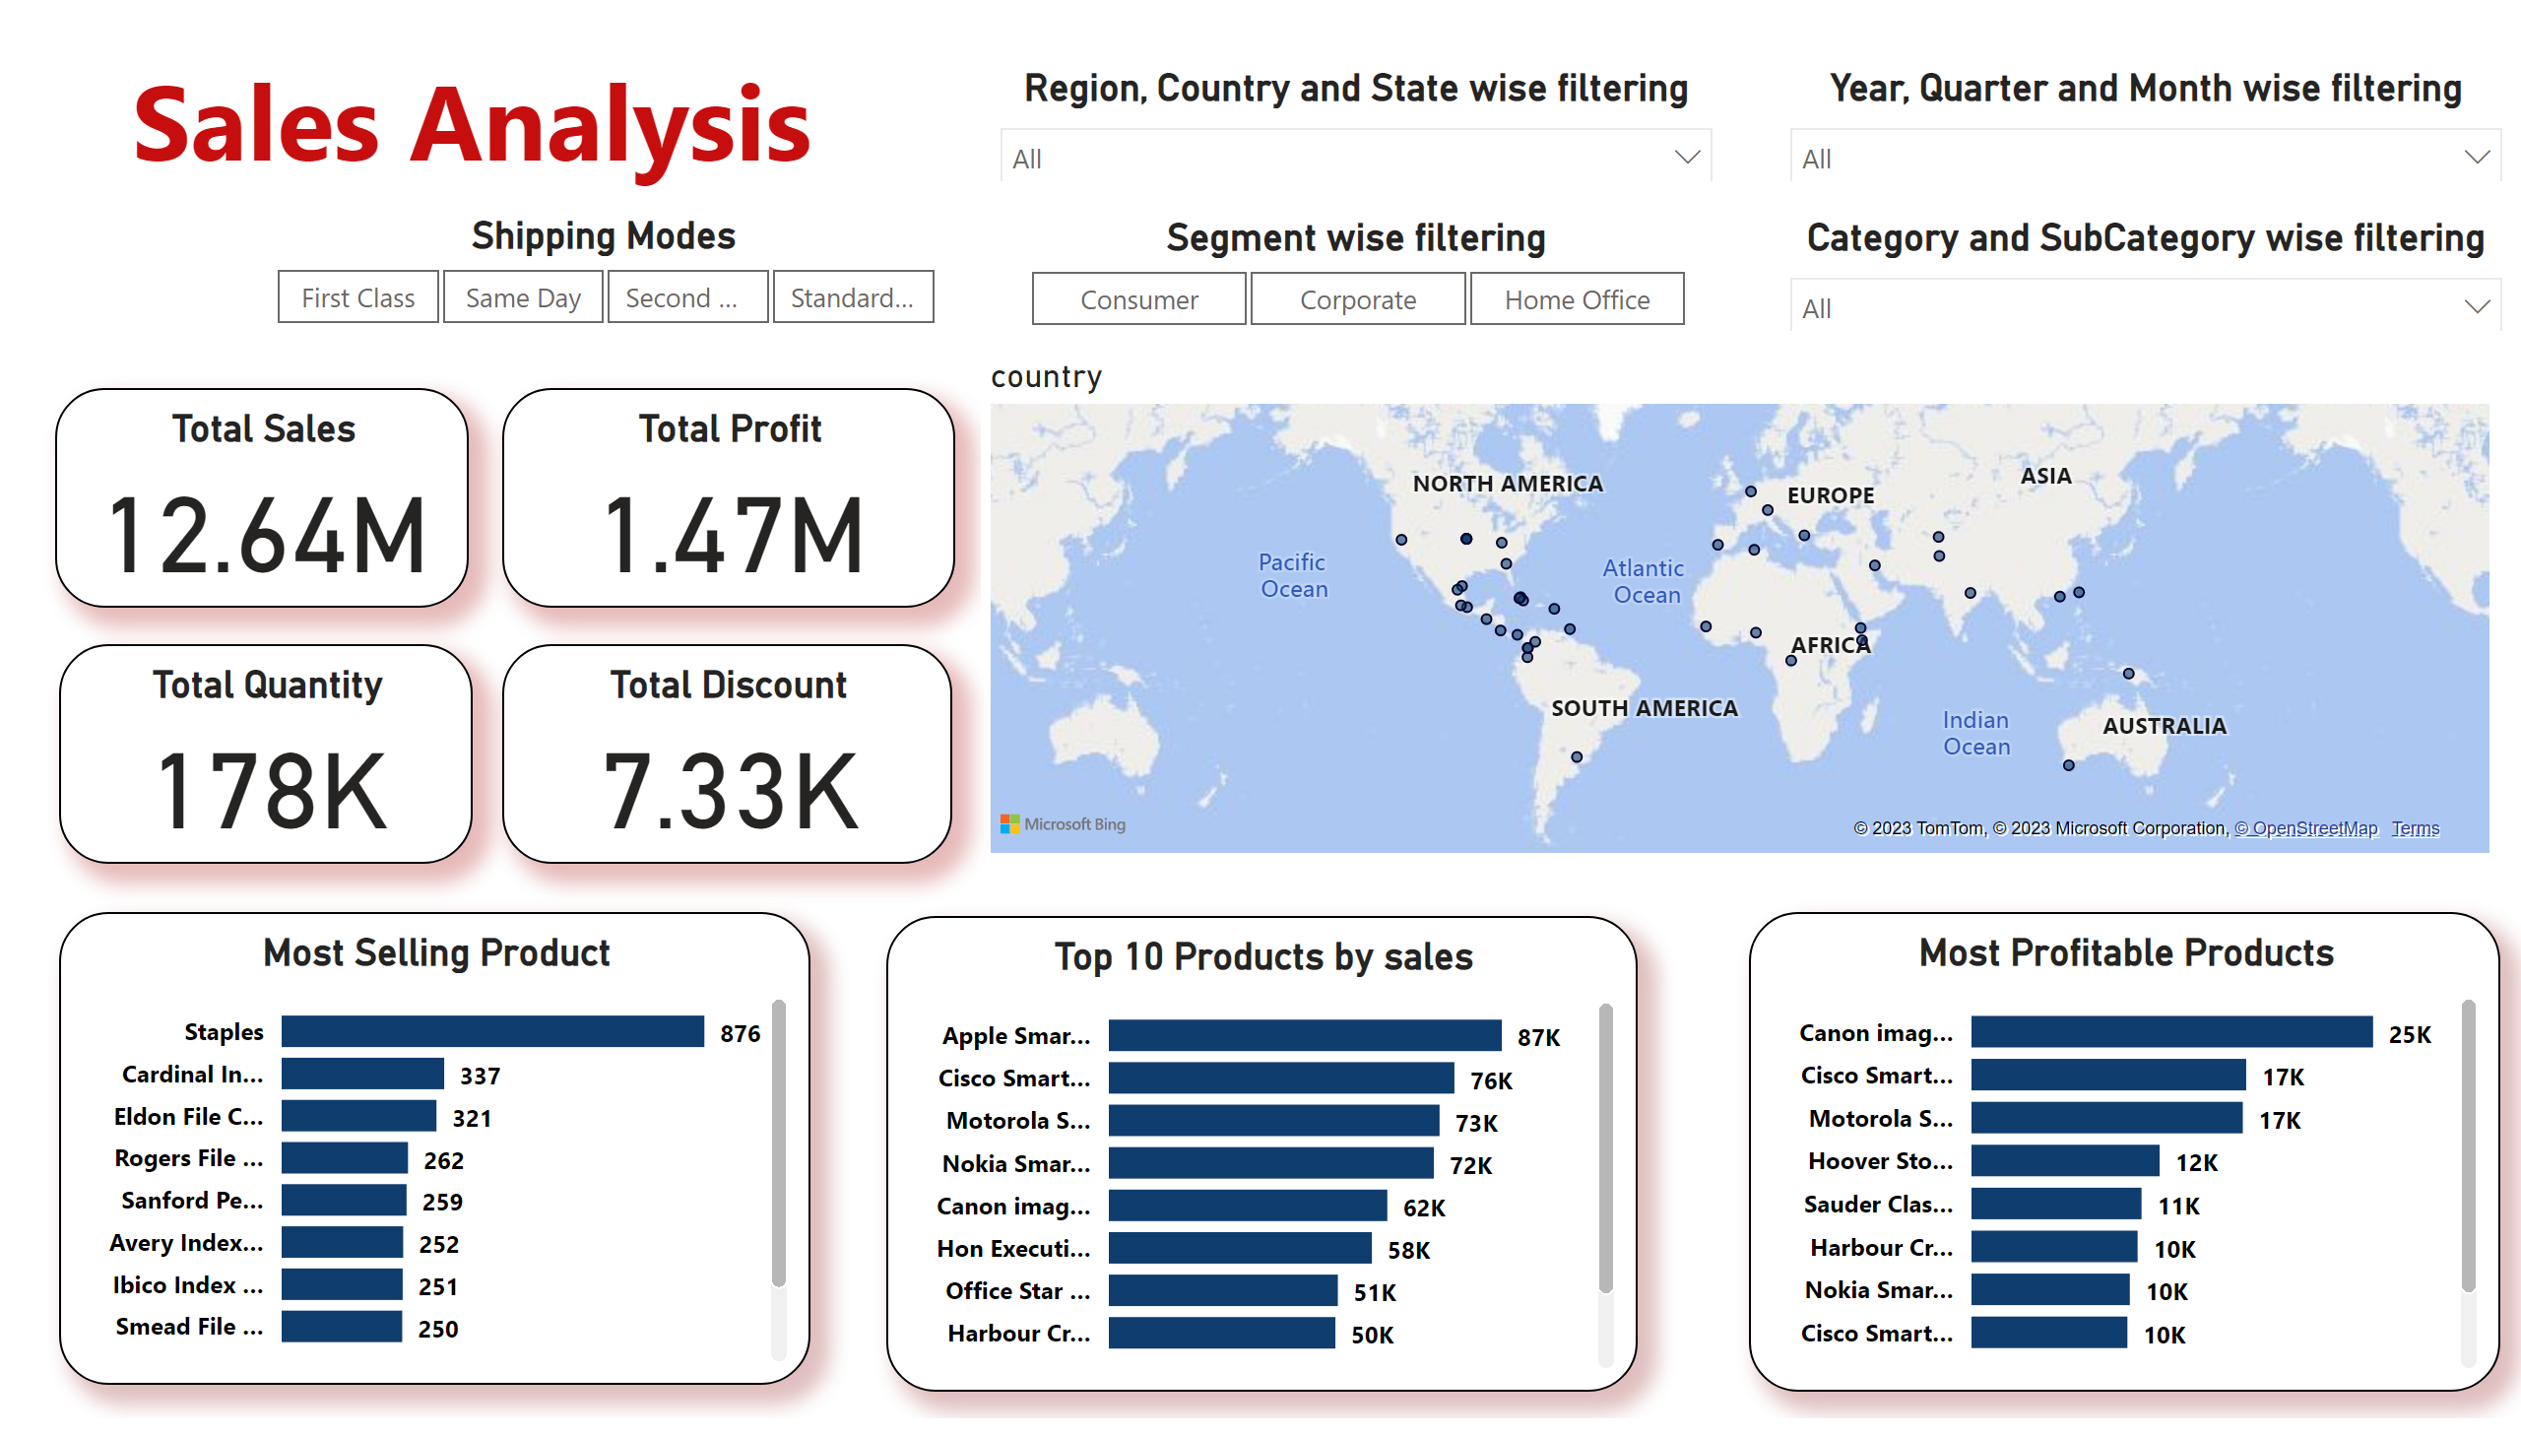
Page 1
Notes:
Most Selling Product
No alt text provided
Top 10 Products by sales
No alt text provided
Most Profitable Products
No alt text provided
Year, Quarter and Month wise filtering
No alt text provided
Region, Country and State wise filtering
No alt text provided
Category and SubCategory wise filtering
No alt text provided
Segment wise filtering
No alt text provided
textbox
No alt text provided
Total Sales
No alt text provided
Total Profit
No alt text provided
Total Quantity
No alt text provided
map
No alt text provided
Total Discount
No alt text provided
Shipping Modes
No alt text provided

Slide 3
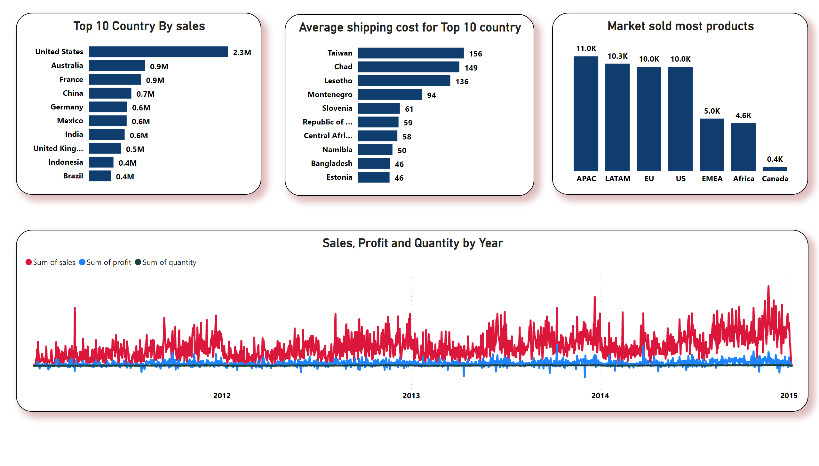
Page 2
Notes:
Top 10 Country By sales
No alt text provided
Average shipping cost for Top 10 country
No alt text provided
Market sold most products
No alt text provided
Sales, Profit and Quantity by Year
No alt text provided
slicer
No alt text provided
slicer
No alt text provided
slicer
No alt text provided
slicer
No alt text provided
slicer
No alt text provided

